Slide 1
SGYO – Yount Elevator Addition
WPVAR18-0007

Slide 2
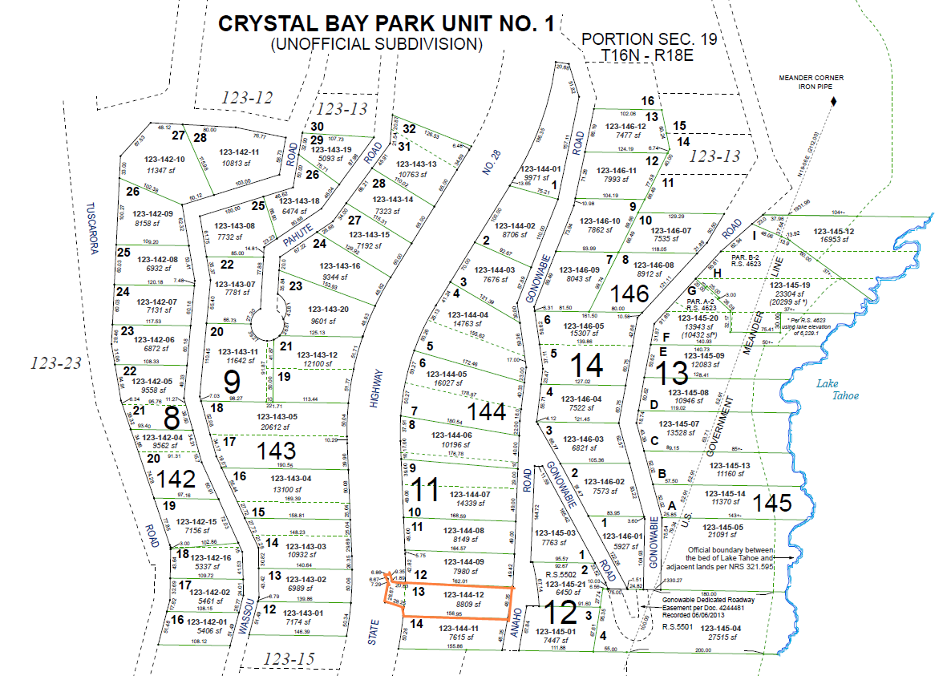

Slide 3
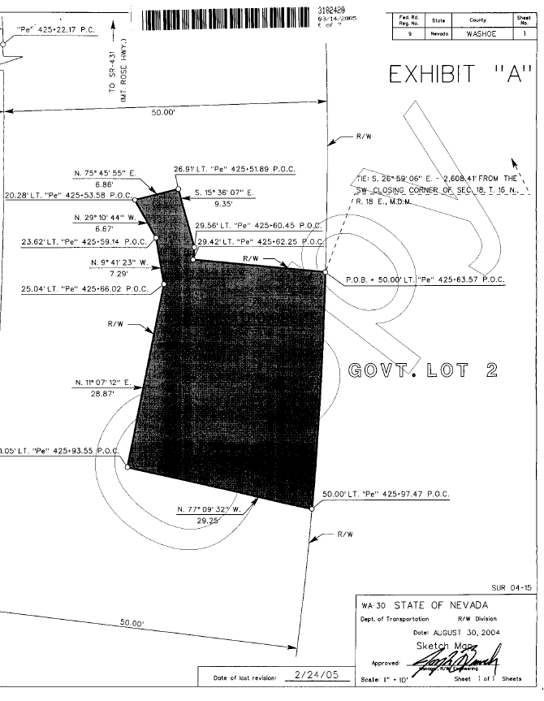

Slide 4
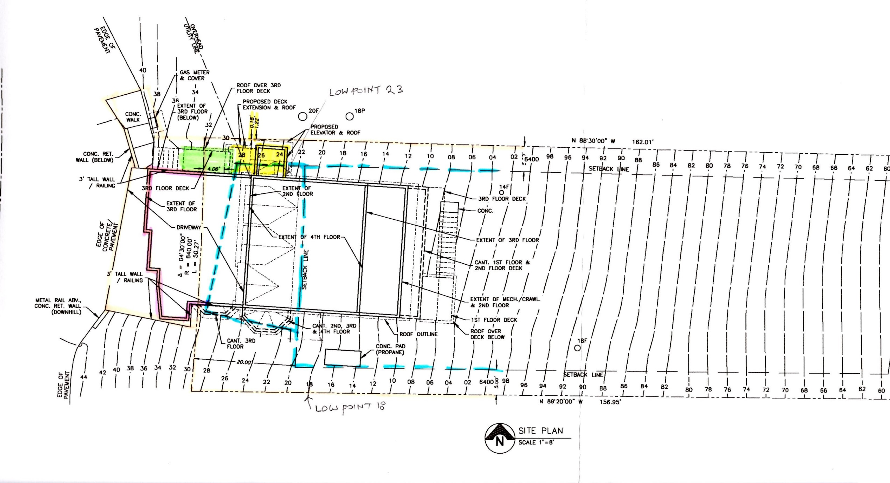

Slide 5
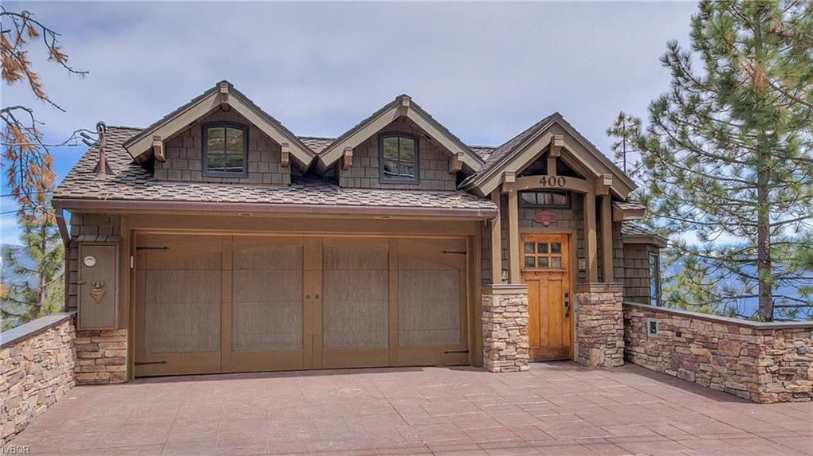

Slide 6
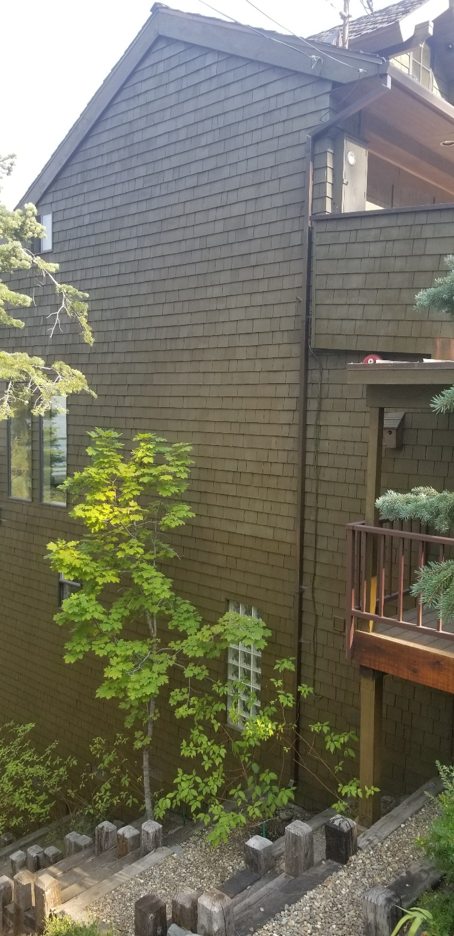
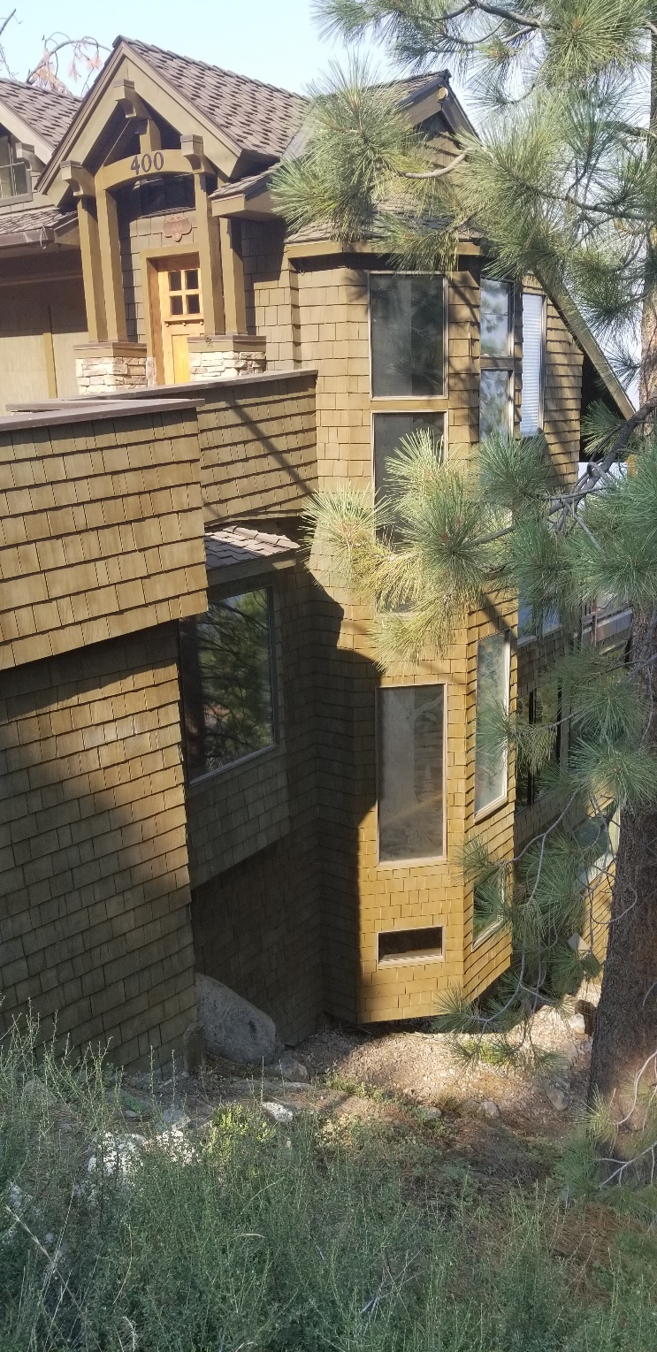
North Side
South Side

Slide 7
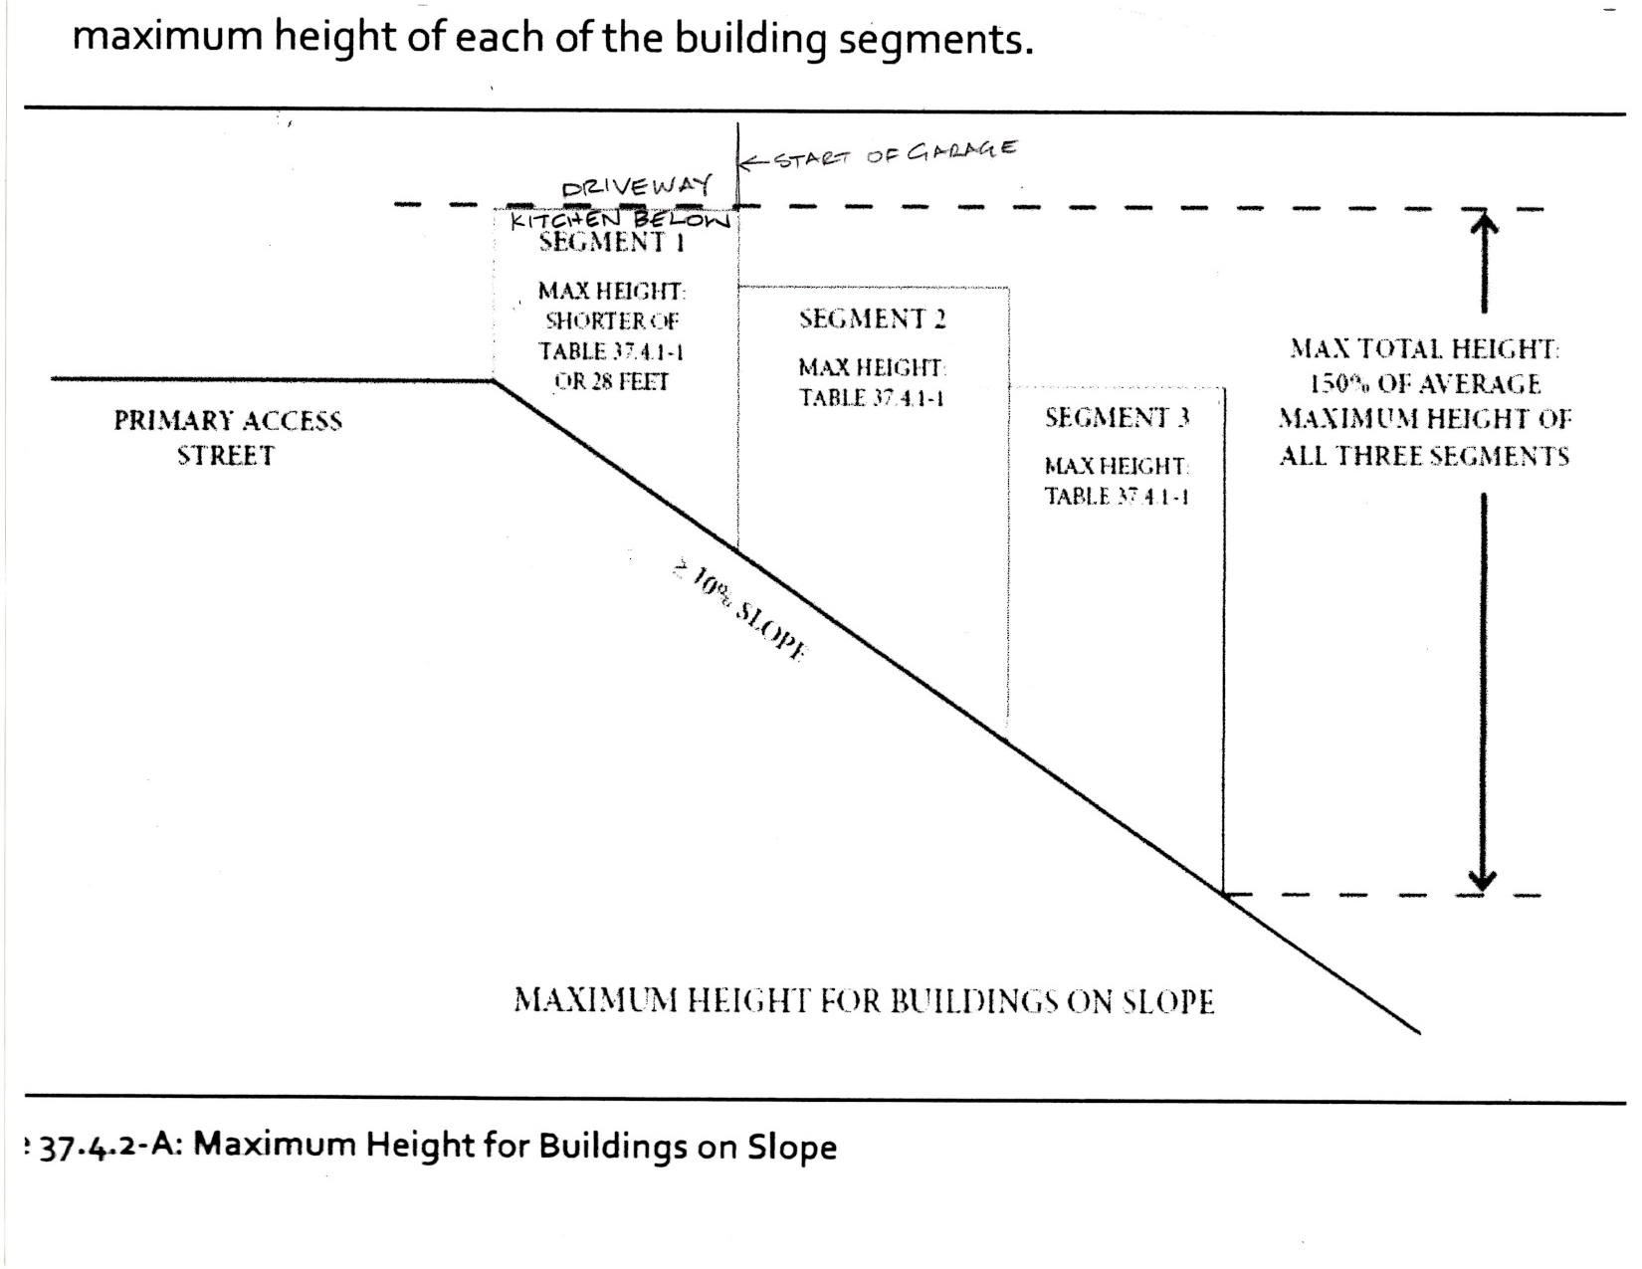

Slide 8
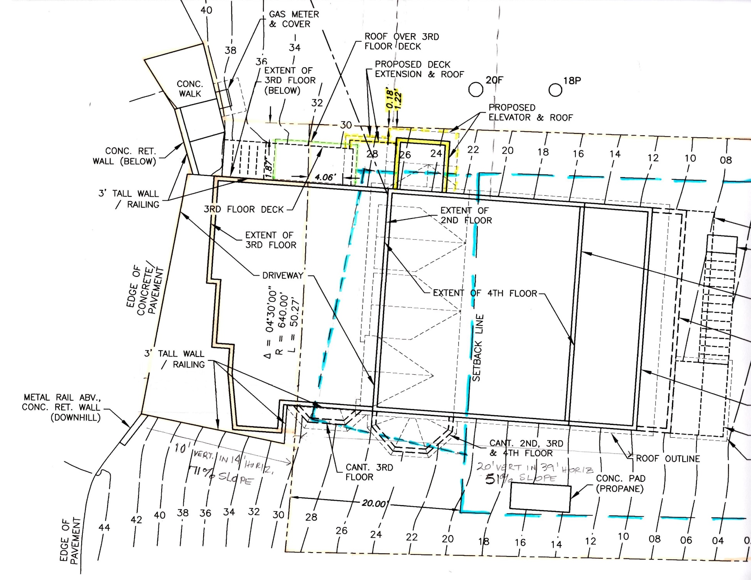
Segment 1
Segment 2
WALL IS 1.22’
FROM PL

Slide 9
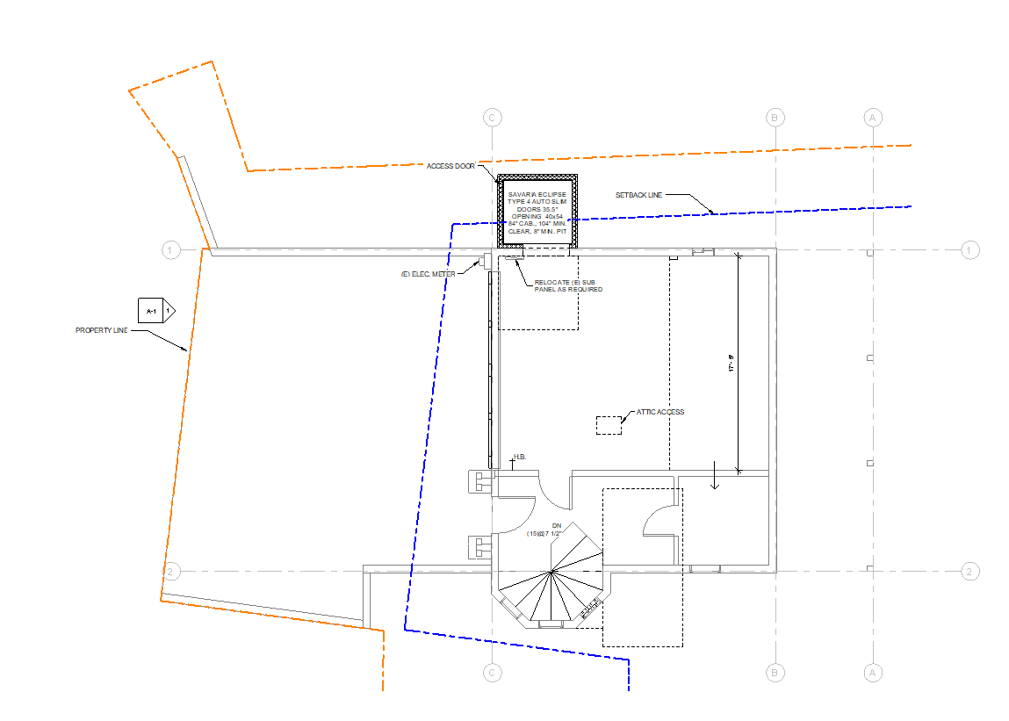
4th Floor

Slide 10
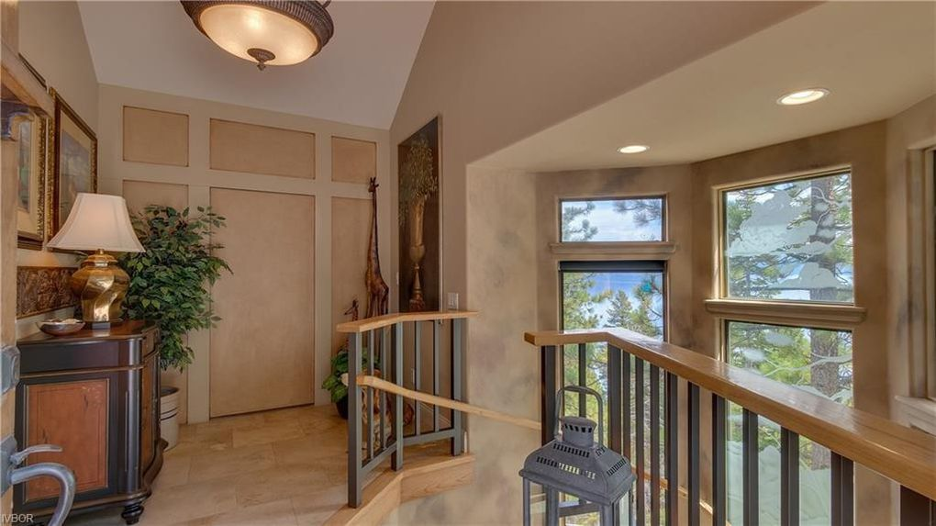

Slide 11
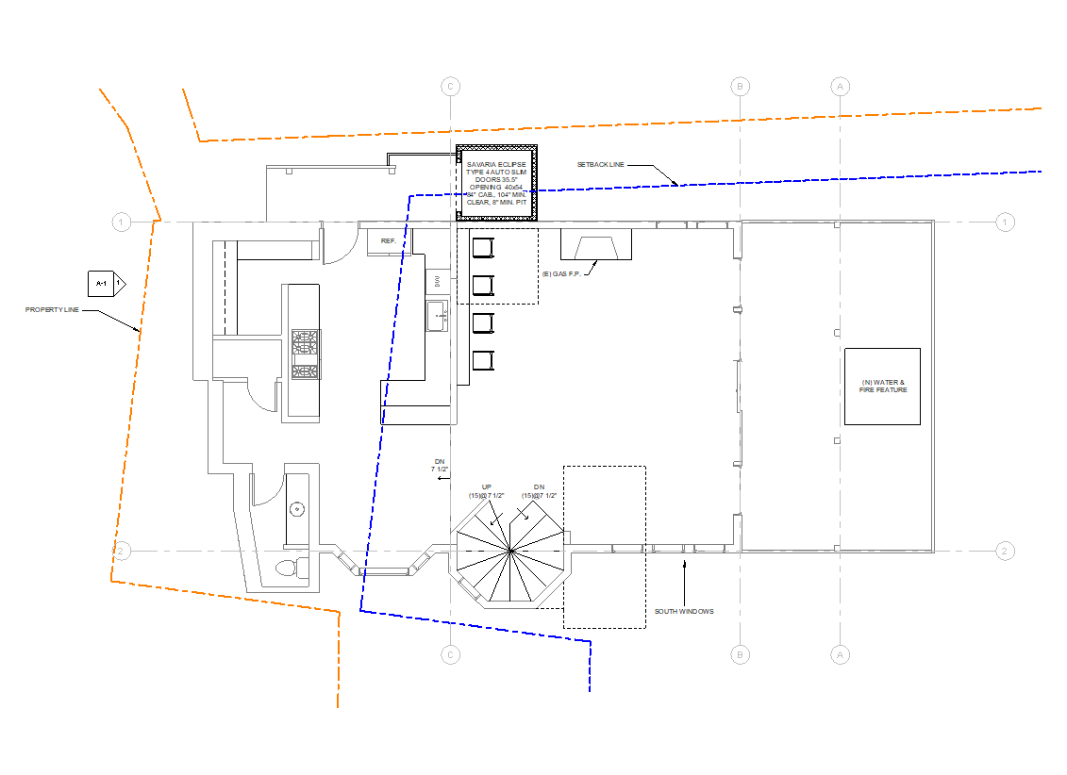
3rd Floor

Slide 12
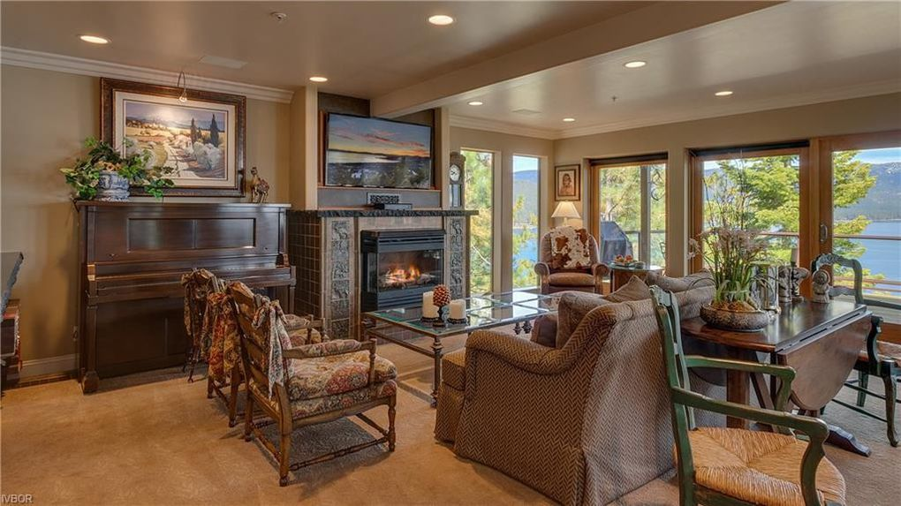
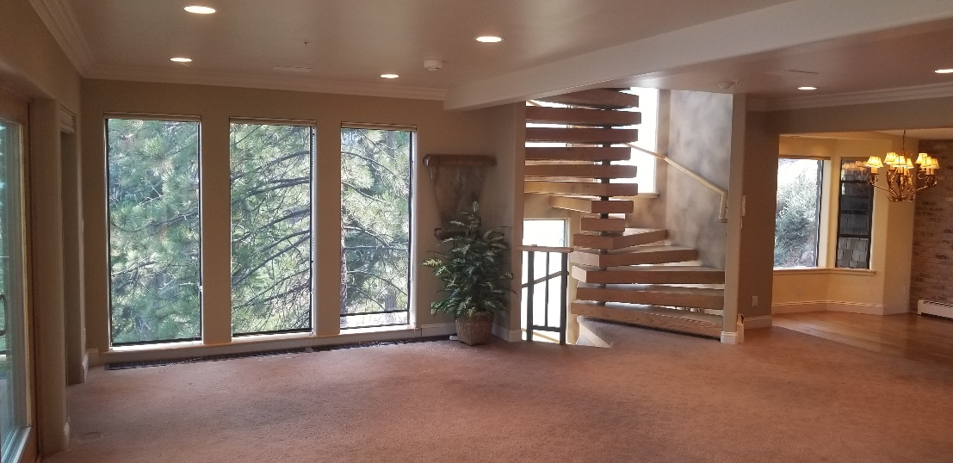
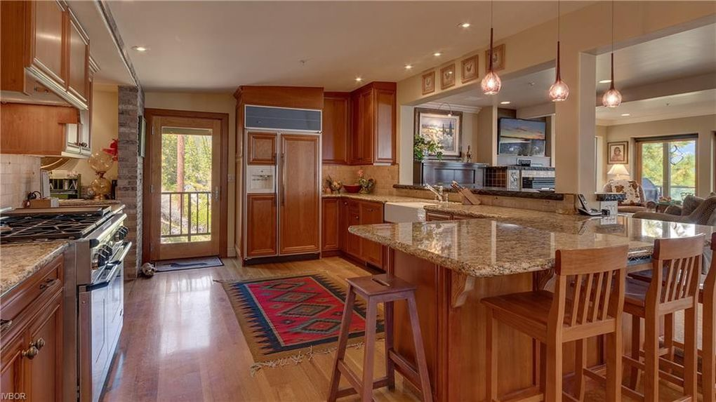

Slide 13
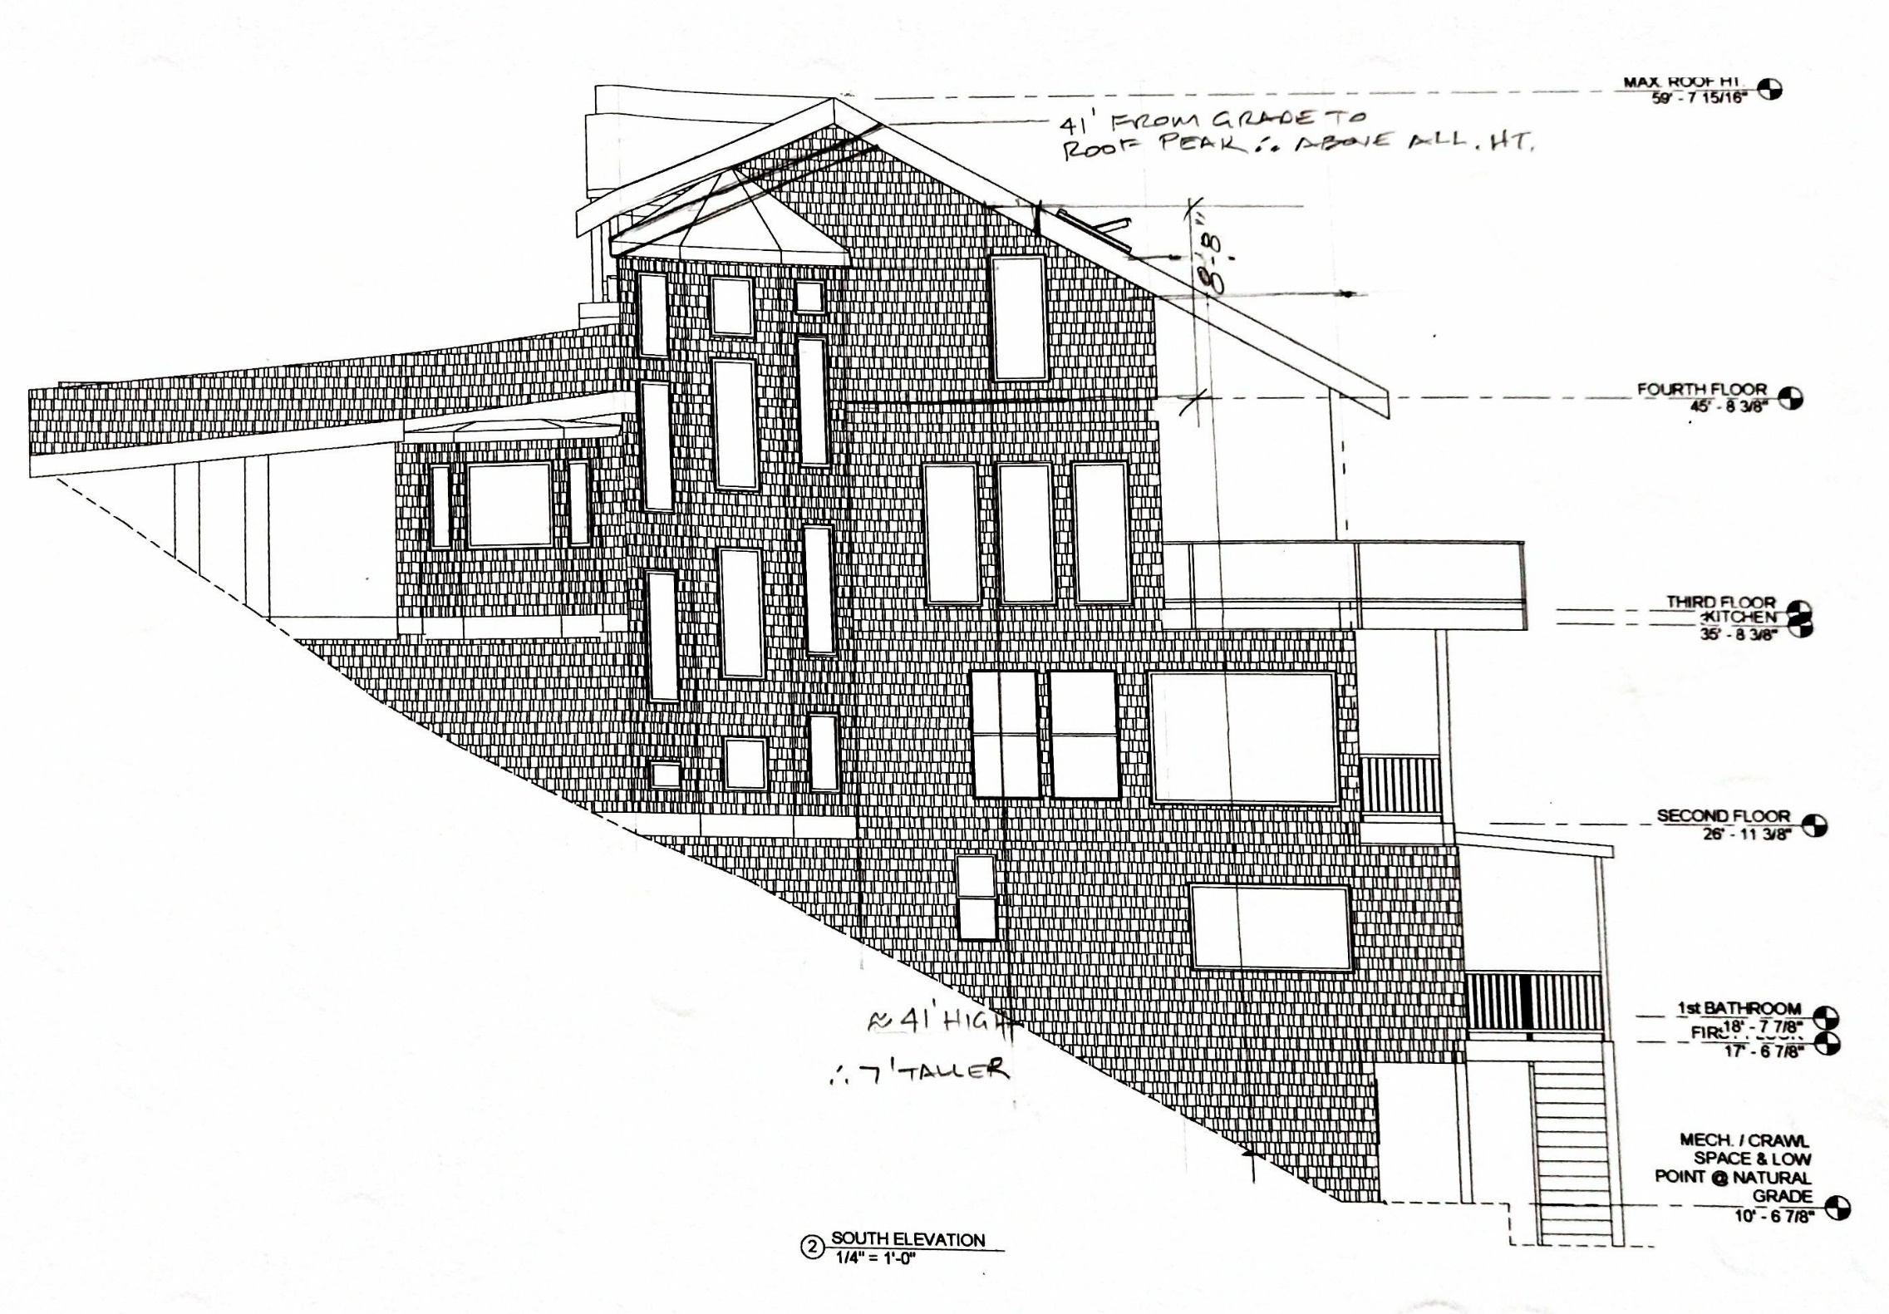

Slide 14
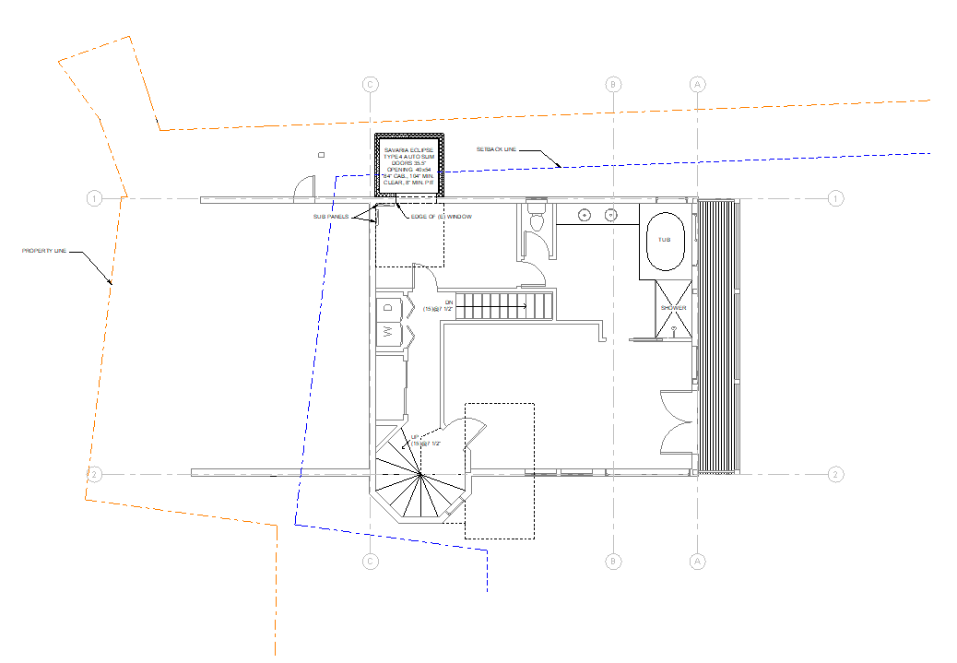
2nd Floor

Slide 15
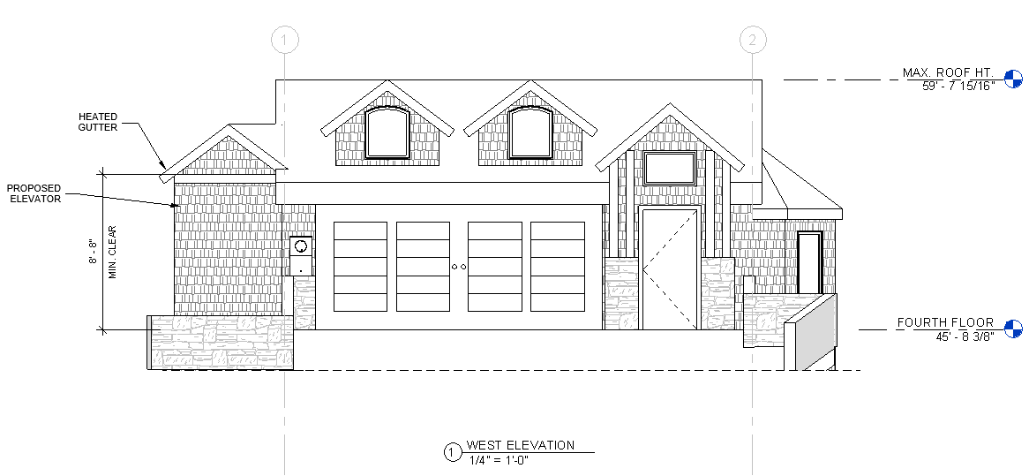

Slide 16
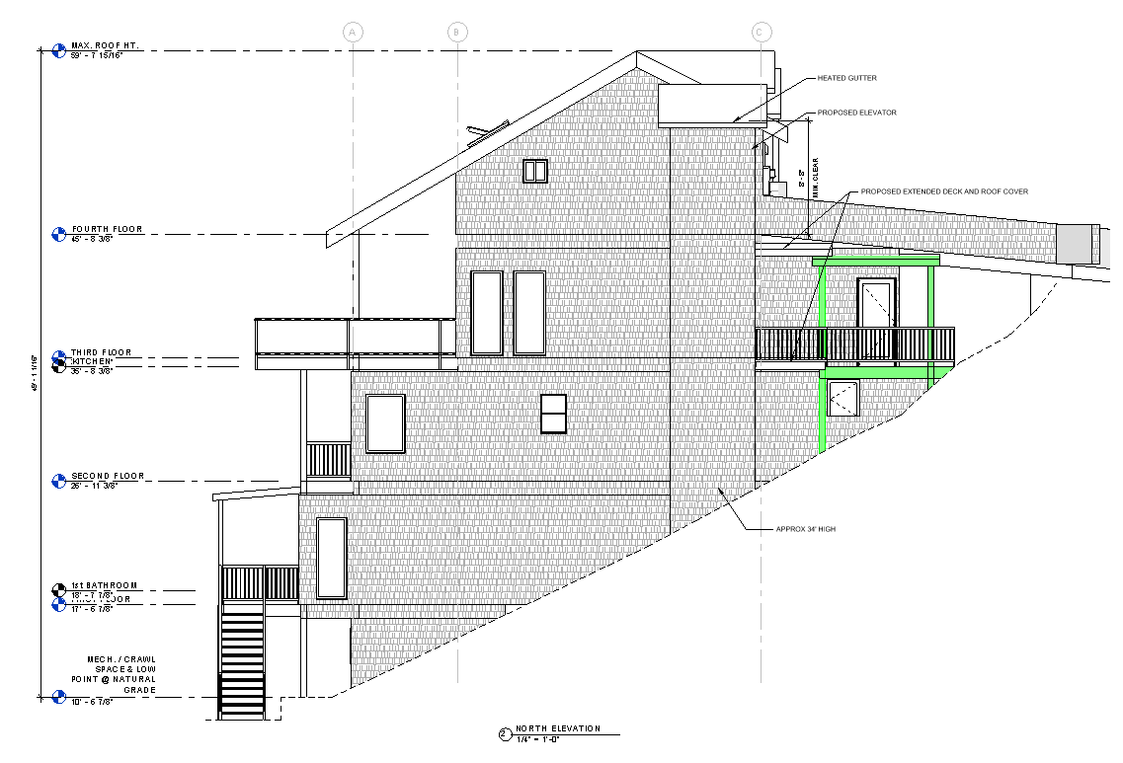

Slide 17
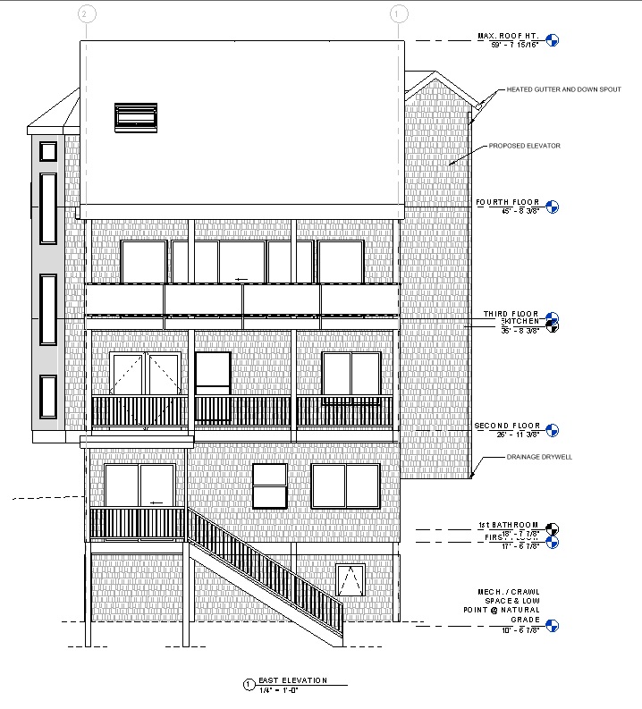

Slide 18
Conclusion
When considering the change in the front property line, we are only requesting a variance to the north side setback of 1.22’ for the wall of the elevator shaft, which is a reasonable accommodation under the fair housing act
Special Circumstance
Extremely steep lot as evidenced by NDOT providing over 29’ into the 50’ wide right of way to accommodate the structure necessary for access on the this 71% sloped area
The 51% slope on the property where the remainder of the house rests causes the existing home to exceed TRPA allowable height
The width of the property is less than allowed by zoning
The CAB unanimously consideres this a hardship property because of all these items
No Special Privileges
There are 3’ to 1.5’ setbacks approved at 515 and 485 Gonowabie where elevators were added and these had deep excavations next to Forest Service property, unlike what we are proposing
Many of the 3&4 story homes in the area have elevators
No Detriment
There will be heated gutters on the 8’ of eave adjacent to the Forest Service lot to prevent snow fall and accumulation

